Slide 1
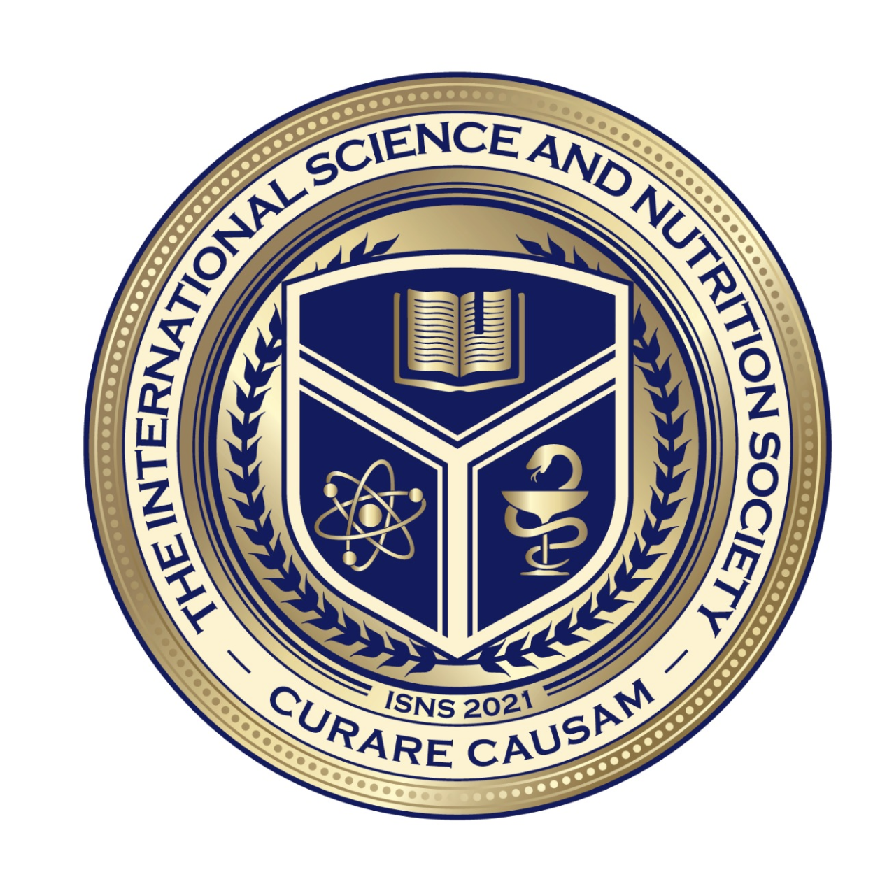
We will get started shortly.
International Science Nutrition Society – CURARE CAUSAM - ISNS 2023

Slide 2
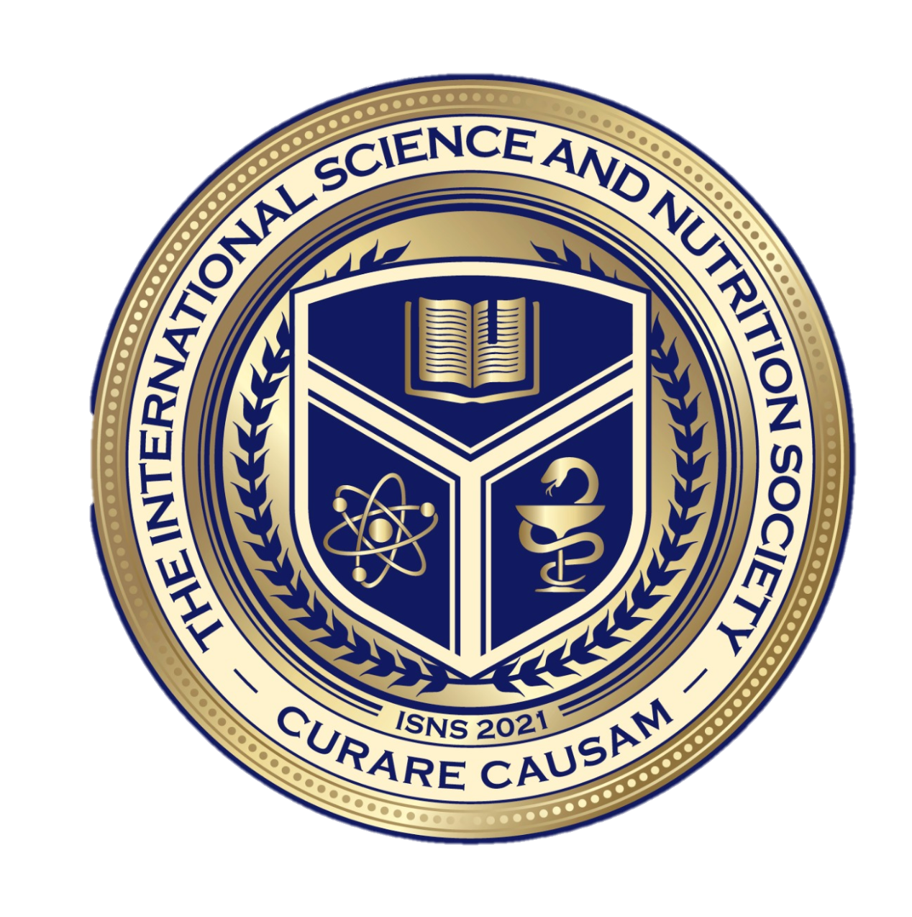
ISNS CASE STUDY
With Dr. Norbert Ketskes on Atopic Dermatitis (Eczema)
International Science Nutrition Society – CURARE CAUSAM - ISNS 2023

Slide 3
Medical Disclaimer
The information provided is for educational purposes and is not intended as medical advice, or a substitute for the medical advice of a physician or other qualified health care professional. This is for science and educational purposes only and cannot be used in any aspect for sales or marketing. You should not use this information for diagnosing a health or fitness problem or disease. You should always consult with a doctor or other health care professional for medical advice or information about diagnosis and treatment. This is Confidential. Do not distribute—for scientific educational purposes only.
International Science Nutrition Society – CURARE CAUSAM - ISNS 2023

Slide 5
DR. NORBERT KETSKÉS, MD
Dr. Norbert Ketskés M.D. is one the most acknowledged gastroenterologist in Hungary, specializing in natural and organic nutritional solutions, leading the well-known Primus Labor, a private clinic offering personalized nutritional advices to its patients.
Scientific Adviser of ISNS
Medical Partner of the Hungarian Olympic Committee since 2015
Member of the Medical board of Hungarian Karate Association since 2015
Leader of the Primus Labor Private Medical Clinic since 2013
Working as a Family Doctor 1999 – 2012
International Science Nutrition Society – CURARE CAUSAM - ISNS 2023

Slide 6
CSISZTU ZSUZSA
Television - Presenter, Anchor, Editor, Journalist and Sports Lawyer, Sport-diplomat
Spokesperson of the Giro d’Italia Grande Partenza, (Road-Cycling World -Tour Championship)
Spokesperson of the FINA (Swimming and Waters poets World Championship)
2022 Vice-President of the Hungarian Sports Journalists’ Association
Member of the Hungarian Olympic Committee Member of the Advisory Board of the Hungarian Olympic Academy
Newly Elected Vice-President of the International Sports Journalists Association, the first female ever in the field from her homeland, and third globally since 1924 (AIPS)
International Science Nutrition Society – CURARE CAUSAM - ISNS 2023

Slide 7
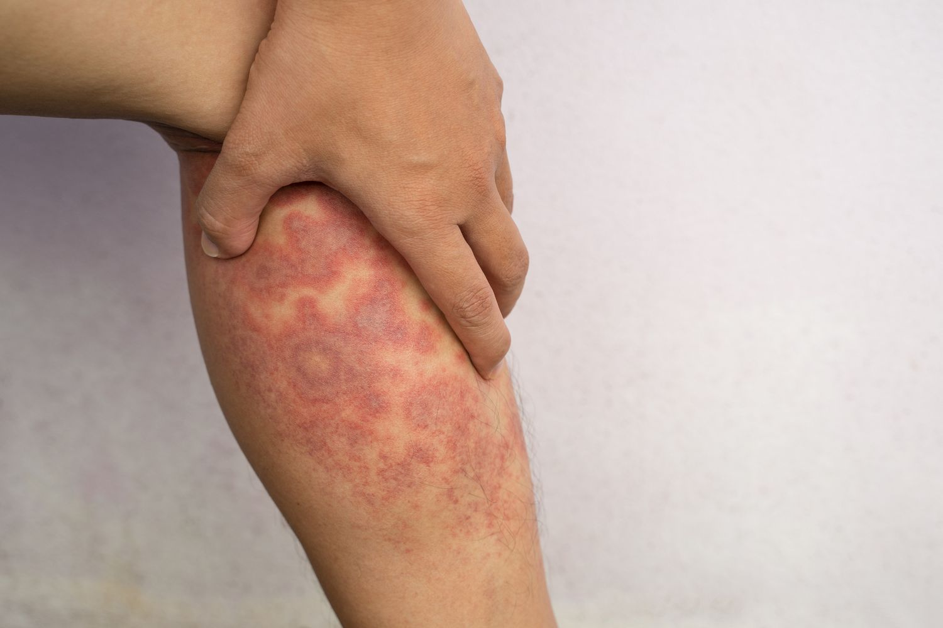
What is Eczema?
Eczema, or atopic dermatitis, is a very common chronic skin disease that can develop during childhood, adolescence, or adulthood, and it can range from mild to severe. It is so common that 31 million Americans have some form of eczema. Usually, it affects children the most, and in many cases, it can disappear with age. The exact cause of eczema is still not determined, but researchers believe it arises from interactions between genes and environmental triggers.
International Science Nutrition Society – CURARE CAUSAM - ISNS 2023

Slide 8
Affected
Areas
International Science Nutrition Society – CURARE CAUSAM - ISNS 2023

Slide 9
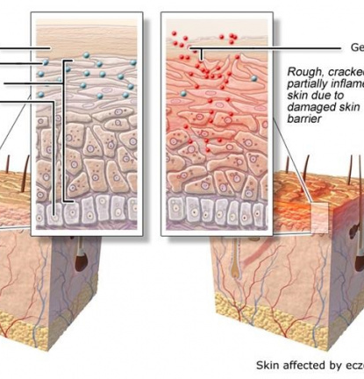
Causes
Our skin is made up of an outer layer (epidermis), a middle layer (dermis) and an inner layer (subcutaneous layer). This outer layer has different layers too: the basal layer, the spinous or prickle-cell layer, and the corneal or horny layer (enlarged in the diagram below). The corneal layer – the visible part of the skin – protects the body from germs. It renews itself constantly as new cells grow from the basal layer.
In people with eczema, the corneal layer doesn't provide enough protection because it is damaged by the inflammatory response occurring in the skin. Another possible cause is a mutated gene that affects the production of the protein filaggrin, which the body needs to make the skin's outer layer. Because there isn't enough filaggrin, the balance of fats in the skin changes, causing the skin to lose a lot of moisture.
International Science Nutrition Society – CURARE CAUSAM - ISNS 2023

Slide 10
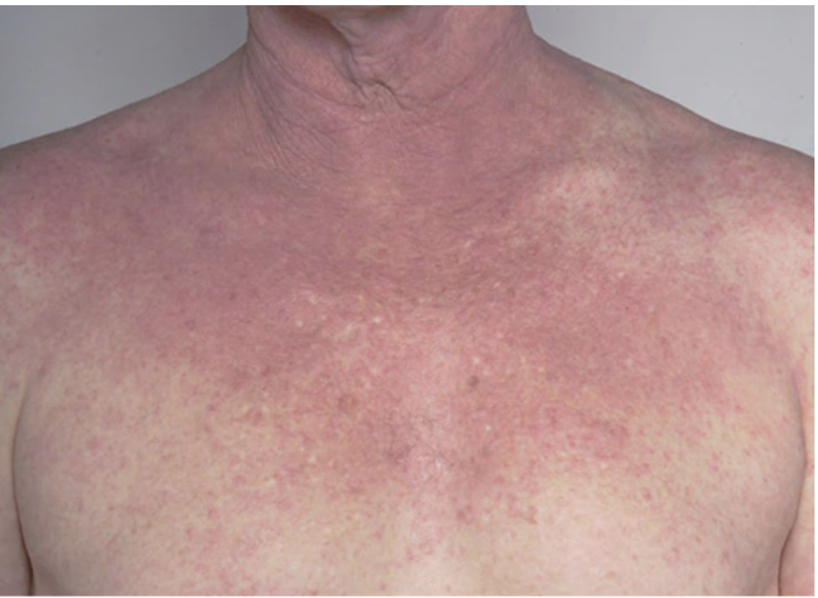
Signs and Symptoms
Atopic dermatitis (eczema) symptoms can appear anywhere on the body and vary widely from person to person.
Atopic dermatitis often begins before age 5 and may continue into the teen and adult years. For some people, it flares then clears up for a time, even for several years
Complications
International Science Nutrition Society – CURARE CAUSAM - ISNS 2023

Slide 11
ECZEMA DIAGNOSIS & TREATMENT
Currently, there is no cure for eczema, but there are ways to prevent flare-ups and treatments to manage it. To prevent flare-ups, avoid allergens, change dietary habits, moisturize the skin, avoid stress and anxiety, heavy sweating, or certain scents or fabrics. Treatments for eczema, depending on age and severity, include over-the-counter (OTC) remedies, topical medication, phototherapy, immunosuppressants, and biologic drugs. If not treated properly, bacteria can sometimes cause infection to the skin. Many people look for alternative treatments such as herbal products or dietary supplements to manage this disease, but there has not been enough research to prove its efficacy.
International Science Nutrition Society – CURARE CAUSAM - ISNS 2023

Slide 12
CASE STUDY
Patient:Female
Age: 36 years
Medical history:No significant medical history; no previous skin conditions.
History: She's family history revealed that her mother had a history of atopic dermatitis (eczema) during childhood, although it had improved significantly as she grew older.
Symptoms:
She has with persistent and itchy skin rashes on various parts of her body, including the inside of her elbows, back of her knees, and neck. The symptoms started approximately 10 months ago and have been recurring in episodes.
Physical Examination (Dermatologist) :The specific locations of the rashes and the characteristic appearance of the skin lesions pointed towards eczema.
Allergy Testing: Since eczema is often associated with allergies, she underwent allergy testing to identify any potential triggers. The tests revealed sensitivity to dust mites, dog,cat hair, and certain tree pollen.
International Science Nutrition Society – CURARE CAUSAM - ISNS 2023

Slide 13
Conventional Treatment
There is currently no cure for eczema, but many children find their symptoms naturally improve as they get older.
The main treatments for eczema are:
Emollients (moisturizers)- used every day to stop the skin from becoming dry
Topical corticosteroids- creams and ointments used to reduce swelling and redness during flare-ups.
------------------------------------------------------------------
Allergen Avoidance
Antihistamines (cetirizine or loratadine) (as needed): Antihistamines can help alleviate itching
International Science Nutrition Society – CURARE CAUSAM - ISNS 2023

Slide 14
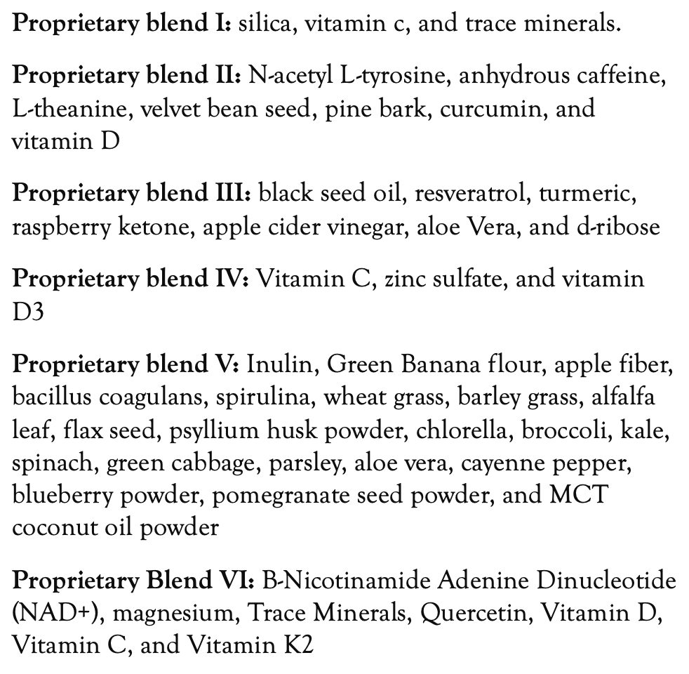
Method
PROPRIETARY BLENDS LEGEND
Proprietary blend I: 2x5 drops, morning and evening, for 3 days, then every 3 days then increased by 1-1 drops every 3 days to 2x10
Proprietary blend II :2 in the morning
Proprietary blend III:1 sachet in the morning for 3 days then 1 sachet in the morning and 1 sachet in the evening
Proprietary blend IV: 1/2 teaspoon in the
morning
Proprietary blend V: 1 teaspoon in the
in the evening for 7 days, then 1 teaspoon in
the morning and 1 teaspoon in the evening
Proprietary blend VI: 1 in the
morning and 1 in the evening
International Science Nutrition Society – CURARE CAUSAM - ISNS 2023

Slide 15
Additional Treatment
Stress management!
Special diet!
(The state of the digestive system is extremely important!!)
International Science Nutrition Society – CURARE CAUSAM - ISNS 2023

Slide 16
Results
After 1 months:
Eczema symptoms improved significantly.
(Red, inflamed patches on she's skin have reduced, the itching
also decreased)
Reduce the frequency and severity of her flare-ups.
After 2 months:
Her symptoms continued to improve significantly. The itching has stopped!
She had no flare-ups in the second month!
She has been able to steadily reduce her medication.
She was able to lead a more comfortable and symptom-free life!
International Science Nutrition Society – CURARE CAUSAM - ISNS 2023

Slide 17
Research Studies
International Science Nutrition Society – CURARE CAUSAM - ISNS 2023

Slide 18
Potential of Curcumin in Skin Disorders Laura Vollono, Mattia Falconi, Roberta Gaziano, Federico lacovelli, Emi Dika, Chiara Terracciano, Luca Bianchi, and Elena Campione.
We examined the most relevant in vitro and in vivo studies published to date regarding the use of curcumin in inflammatory, neoplastic, and infectious skin diseases, providing information on its bioavailability and safety profile.
Moreover, we performed a computational analysis about curcumin’s interaction towards the major enzymatic targets identified in the literature. Our results suggest that curcumin may represent a low-cost, well-tolerated, effective agent in the treatment of skin diseases.
Altogether this experimental evidence suggests that curcumin alone or combined with phototherapy may be a potential and very promising candidate in treating bacterial and fungal skin diseases, overcoming the multi-drug resistance of pathogens.
https://www.ncbi.nlm.nih.gov/pmc/articles/PMC6770633/
International Science Nutrition Society – CURARE CAUSAM - ISNS 2023

Slide 19
The Therapeutic Effects of Nigella sativa on Skin Disease: A Systematic Review and Meta-Analysis of Randomized Controlled Trials Naser Nasiri, Mozhde Iiaghi Nezhad, Fariba Sharififar, Mahdieh Khazaneha, Mohammad Javad Najafzadeh, and Neda Mohamadi
The aim of this systematic review was to identify randomized controlled trials that looked at the effects of Nigella sativa in any form on different skin diseases.
This study included 14 records of people who had experienced different types of skin disease including atopic dermatitis, vulgaris, arsenical keratosis, psoriasis, vitiligo, acute cutaneous leishmaniasis, warts, eczema, and acne.
The efficacy of N. sativa essential oil and extract has been demonstrated in most clinical studies. However, more research is needed to completely evaluate and validate the efficacy or inadequacy of therapy with N. sativa, although it appears that it can be used as an alternative treatment to help people cope with skin problems.
https://www.ncbi.nlm.nih.gov/pmc/articles/PMC9744621/
International Science Nutrition Society – CURARE CAUSAM - ISNS 2023

Slide 20
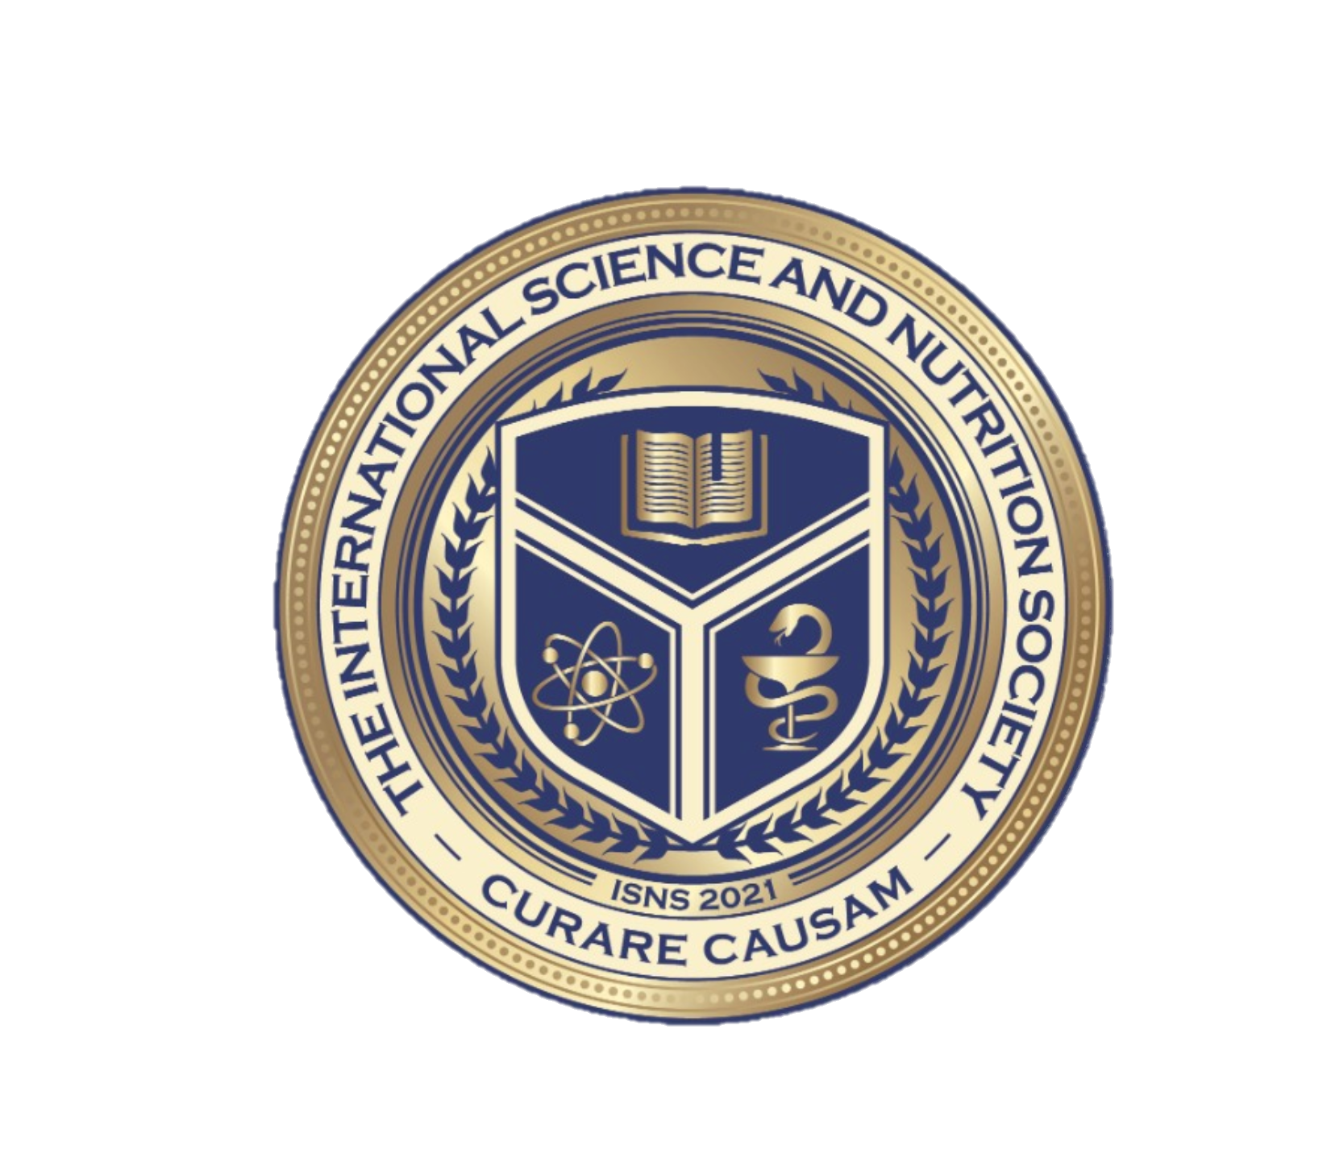
REFERENCES
www.ncbi.nlm.nih.gov/books/NBK279399/
https://pubmed.ncbi.nlm.nih.gov/21913202/
pubmed.ncbi.nlm.nih.gov/21727789/
https://www.ncbi.nlm.nih.gov/pmc/articles/PMC6770633/
https://www.ncbi.nlm.nih.gov/pmc/articles/PMC9744621/
International Science Nutrition Society – CURARE CAUSAM - ISNS 2023

Slide 21
THANKS FOR JOINING US TODAY!

